Slide 1
Python

Slide 2
How to install python
http://python.org/
- documentation, tutorials, beginners guide, core distribution, ...
Books include:
Learning Python by Mark Lutz
Python Essential Reference by David Beazley
Python Cookbook, ed. by Martelli, Ravenscroft and Ascher
(online at http://code.activestate.com/recipes/langs/python/)
http://wiki.python.org/moin/PythonBooks

Slide 3
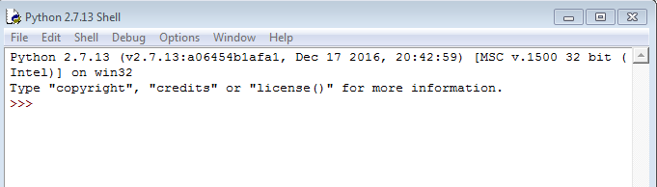
How to run python scripts
1. Command window
2. Shell(IDLE)
3. pycharm

Slide 4
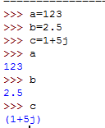
Data Types in python
Python variables do not need explicit declaration to reserve memory space. The declaration happens automatically when you assign a value to a variable.
Numbers
Integers, floating point numbers and complex numbers falls under Python numbers category. They are defined as int, float and complex class in Python.

Slide 5

2. Strings
String literals may be delimited using either single or double quotes. All the characters between the opening delimiter and matching closing delimiter are part of the string.
Methods of strings
Concatenation: +
Ex. A= ‘Hello’
B=‘world’
Print(A+B)
OP: Helloworld

Slide 6
Repetition: *
Ex. A*3
OP: HelloHelloHello
Slice: [] 0 1 2 3 4
Ex. p='hello‘ h e l l o
p[0] -5 -4 -3 -2 -1
OP:’h’
Range slice: [:]
slice(stop)
slice(start, stop, step)
p='hello‘
p[0:]='hello‘
p[:]='hello'
p[0:3]='hel'

Slide 7
Membership: in
Evaluates to true if it finds a variable in the specified sequence and false otherwise.
EX. a = 10
list = [1, 2, 3, 4, 5 ]
a in list
Op: False
Not in membership: not in
Evaluates to true if it does not finds a variable in the specified sequence and false otherwise.
EX. a = 10
list = [1, 2, 3, 4, 5 ]
a not in list
Op: True

Slide 8
.upper()
p=“hello”
p.upper()
OP: HELLO
.lower()
p=“HELLO”
p.lower()
OP: hello
.count() : returns the number of occurrences of a substring in the given string
Syntax: string.count(substring, start, end)
EX. p.count(“h”)
OP: 1
p.count("h", 1, 5)
OP: 0

Slide 9
.find()
Syntax: str.find(sub,start,end)
EX: p.find(‘h’)
OP: 0
EX: p.find('h',1,5)
OP: -1
.replace()
Syntax: str.replace(pattern,replaceWith,maxCount)
EX: p.replace('l','a',1)
OP: 'healo‘
p.replace('h','*')
OP: '*ello'

Slide 10
Number methods
Abs(x)
EX. Abs(-31)
OP: 31
Abs(2+3j)
OP: 3.6055512754639896
Ceil(x): smallest integer not less than x
EX. import math
Math.ceil(3.2)
OP: 4
Cmp(x,y)
a=2
b=3
cmp(a,b)
OP: -1

Slide 11
Exp(x): returns exponential of x: e^{x}
math.exp(2)
7.38905609893065
Floor(x):largest integer not greater than x
math.floor(3.2)
3.0
Log(x):
EX: import math
math.log(10)
OP: 2.302585092994046
Max(x1,x2):
EX: max(1,2,3,4,5,6)
OP: 6

Slide 12
Min(x1,x2)
EX: min(0,-1,-2,-3,-5,-8,00,1)
OP: -8

